Slide 1

The Theory of relativity
An introduction to time travel
Jim barrett
(Slides written by dr Robin Smith)

Slide 2
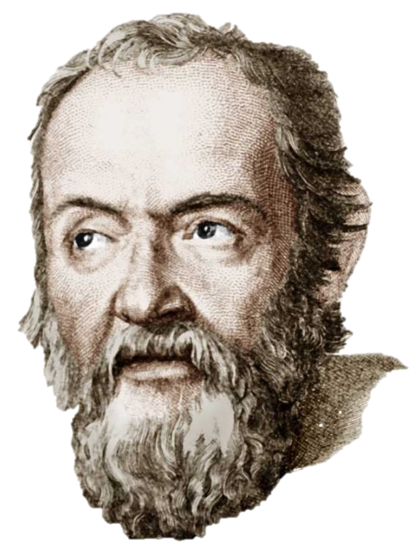
Galilean relativity (1632)
The laws of physics are the same in all inertial frames (non-accelerating frames)
Until this theory people had very strange views on the way the world worked

Slide 3

Galilean relativity (1632)
The laws of physics are the same in all inertial frames (non-accelerating frames)
Until this theory people had very strange views on the way the world worked

Slide 4
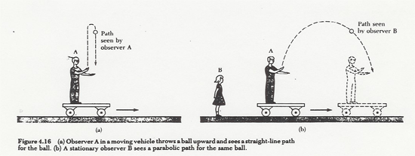
Galilean relativity Demonstration

Slide 5
Galilean relativity Demonstration
5 m/s
? m/s
10 m/s

Slide 6
Galilean relativity Demonstration
3 × 10⁸ m/s
? m/s
10 m/s

Slide 7
Galilean relativity Demonstration
3 × 10⁸ m/s
? m/s
10 m/s
The speed of light is the same in all inertial frames

Slide 8
Special relativity (1905)
The laws of physics are the same in any two inertial reference frames
Two postulates:
The speed of light is constant in all inertial frames

Slide 9
Time dilation
The idea that the way we experience time depends on how fast we are travelling
Results can be derived from the two basic postulates!

Slide 10
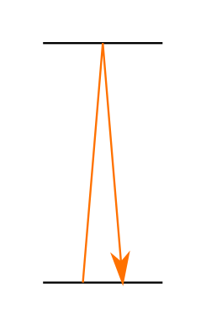
The light clock
A device that keeps time by watching a beam of light pass between 2 mirrors
Length is L
Has a time period of t₀
Such that t₀ = 2L/c
L

Slide 11
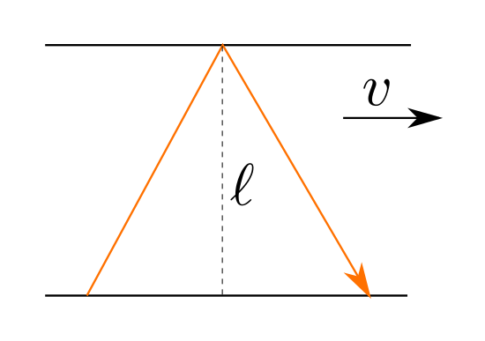
The Moving light clock
L
Can you construct an equation for the amount of time taken for the light to complete one cycle as viewed by someone in the stationary ‘lab frame’ ? t_{lab}

Slide 12
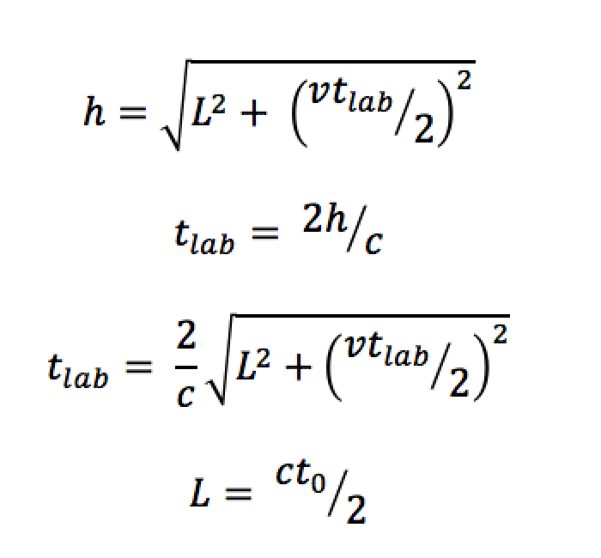
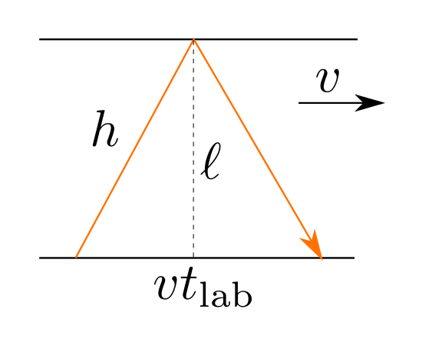
The Moving light clock
L
Notes:
Make sure to rearrange for tlab^2 rather than tlab – makes life a lot easier for the next step
<number>

Slide 13
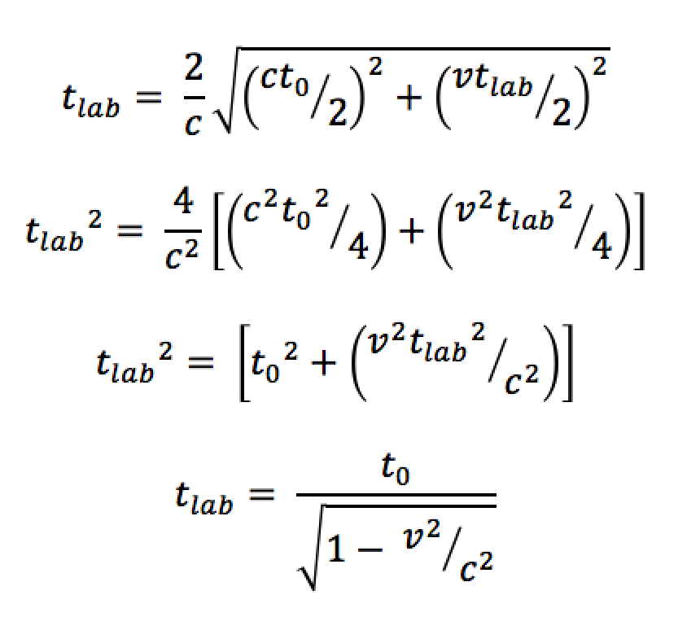
The Moving light clock
L
Notes:
Make sure to rearrange for tlab^2 rather than tlab – makes life a lot easier for the next step
<number>

Slide 14
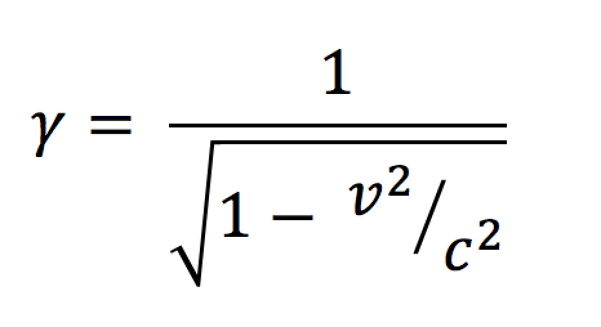
The Moving light clock
L
Notes:
Make sure to rearrange for tlab^2 rather than tlab – makes life a lot easier for the next step
<number>

Slide 15
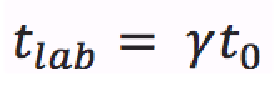
Time Dilation
“A difference of elapsed time between two events as measured by observers moving relative to one another.”

Slide 16
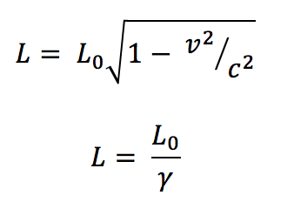
LENGTH Contraction
The length of a moving object will appear shorter when viewed from the stationary lab frame
Easy to derive from the results of time dilation

Slide 17

LENGTH Contraction
Too short by an average of 0.15 m !
How fast must you drive a 3 m car into the garage (2.85 m) in order for a stationary observer to see it fit inside?

Slide 18
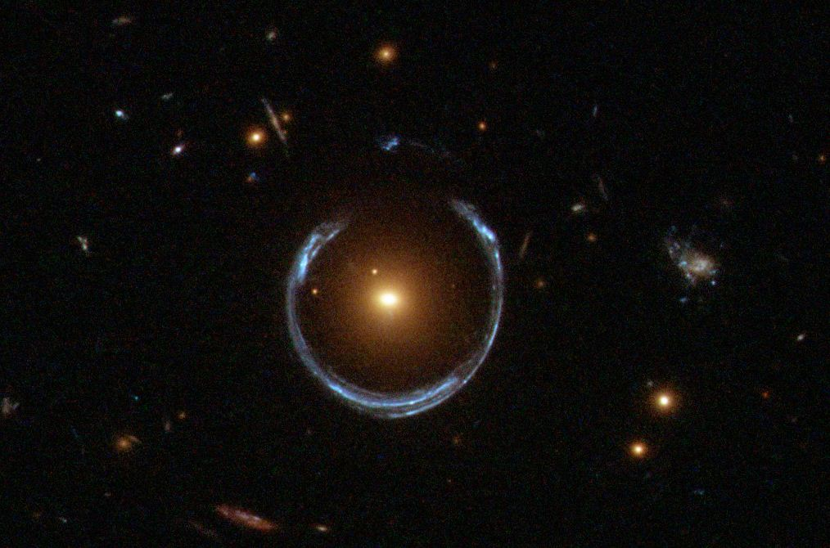
General Relativity (1915): Some motivation

Slide 19
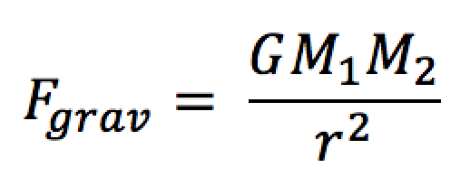
General Relativity (1915): Some motivation

Slide 20
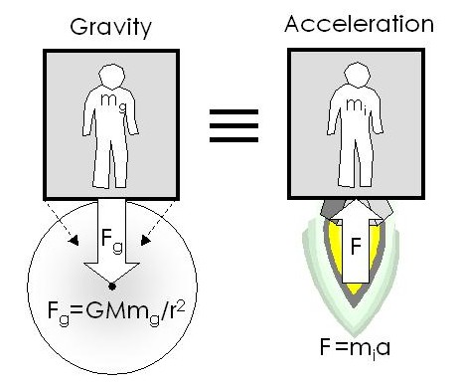

General relativity: The equivalence principle
No physical experiment can distinguish between these two situations!

Slide 21
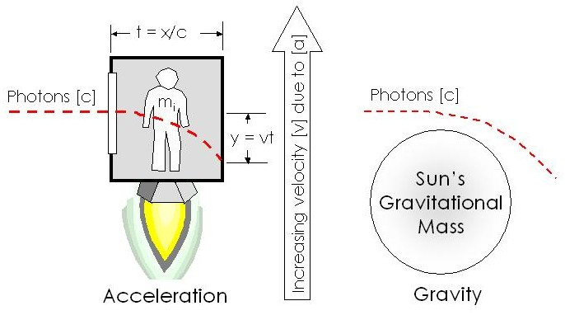
General relativity: The equivalence principle
No physical experiment can distinguish between these two situations!

Slide 22


General relativity: The equivalence principle
?
A laser beam is fired between New York and London (5500 km)
How far does the beam fall under gravity? Treat the laser beam as a standard projectile falling at 10 m/s² and travelling at 3 × 10⁸ m/s

Slide 23
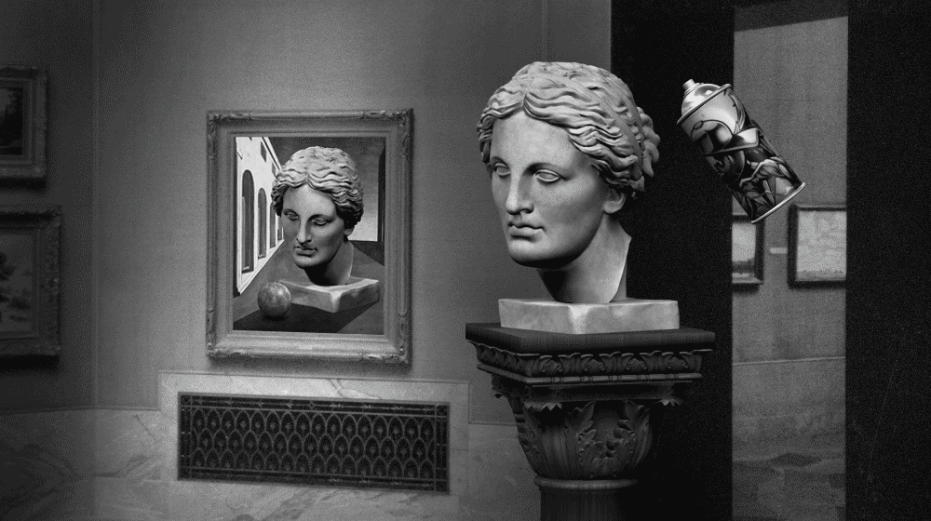
Quantum mechanics and relativity
Entanglement

Slide 24
Quantum Weirdness
Entanglement and measurement problem
Pair of entangled quantum particles

Slide 25
Quantum Weirdness
Entanglement and measurement problem
Each particle can have spin-up or spin-down

Slide 26
Quantum Weirdness
Entanglement and measurement problem
Each particle can have spin-up or spin-down

Slide 27
Quantum Weirdness
Entanglement and measurement problem
Each particle can have spin-up or spin-down

Slide 28
Quantum Weirdness
Entanglement and measurement problem
Each situation is 50% probable
The system is in a superposition of both options until it is measured
Each particle can have spin-up or spin-down

Slide 29
Quantum Weirdness
Entanglement and measurement problem
Separate the particles to opposite sides of the universe

Slide 30
Quantum Weirdness
Entanglement and measurement problem
Measure the spin of particle A
50% chance of up
50% chance of down

Slide 31
Quantum Weirdness
Entanglement and measurement problem
Measured as up

Slide 32
Quantum Weirdness
Entanglement and measurement problem
The state of particle B will ‘collapse’ into the spin-down state, even though it is too far away to tell that particle A was measured

Slide 33
Quantum Weirdness
Entanglement and measurement problem
The information that particle A was measured is transmitted instantaneously to particle B

Slide 34
Quantum Weirdness
Entanglement and measurement problem
This is faster than the speed of light so it disobeys the laws of special relativity

Slide 35
The twins paradox
Two twins are born on Earth. One travels to the nearest star (4 ly away) and then returns straight home, at a speed of 0.8 c.
How much younger is the twin on the spaceship compared with the twin that stayed at home, when they return?
Journey is 8 ly which takes 10 years at 0.8 c
γ(0.8 c) = 1 / 0.6
According to the twin on earth, the moving twin should have aged only 6 years
However….
According to the moving twin, the twin on earth should have only aged 6 years…. Which one is correct?

Slide 36
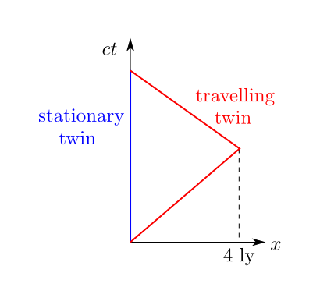
The twins paradox
The situation is not actually symmetric
The stationary twin is always in the same inertial frame
The travelling twin has to swap between two different frames, in order to return home

